Slide 1
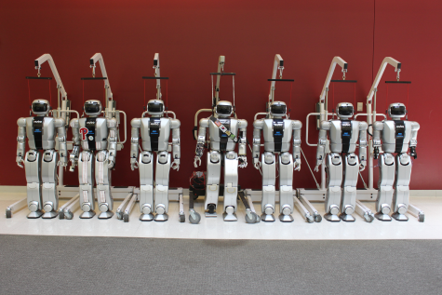










Team DRC-Hubo
Kickoff Meeting, Oct 23-25, 2012, Arlington VA
Presented by Paul Oh (Team Lead, Drexel University)
Approved for Public Release; Distribution Unlimited

Slide 2

















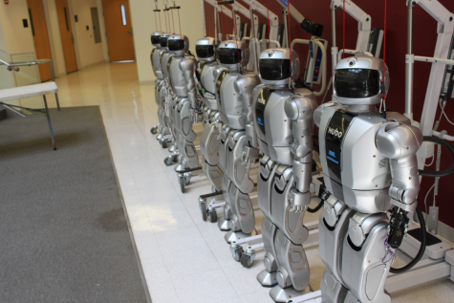


Aligning our “Why” with the DRC Vision…
Background:
Korea: Leadership in Humanoid Design
US: Leadership in AI and IT
http://dasl.mem.drexel.edu/pire/
2007-2012
Less than 3% of US S&T students are prepared for international design teams. Use humanoids to motivate, inspire and train global and systems engineering skills
Major Research Infrastructure (MRI-R2)
2010-2013
Humanoid research is eclectic, ad-hoc and difficult to verify. Acquire 6 Hubo+ to benchmark results, formulate practice, and establish foundational theory
Conviction: The “brains” must be developed in concert with the “body”; realizing the DRC vision must attend to both hardware and underlying motion planning software
Approved for Public Release; Distribution Unlimited

Slide 3
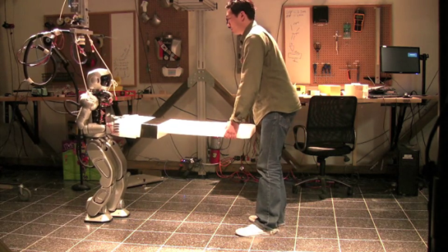
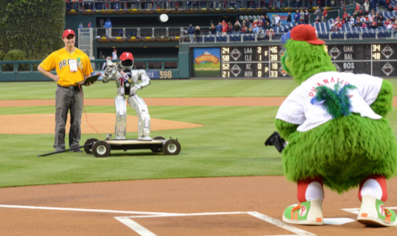
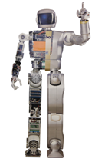
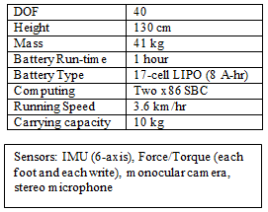
Why Hubo?
(1) Virtual-Hubo
(2) Mini-Hubo
(3) Online-Hubo
Co-Robotics: Human-Humanoid Interaction
04/28/12 Phillies-Cub Game Opening Pitch
To Public Realizations…
http://www.youtube.com/watch?v=OA_u5Q3D57o&feature=g-all-u
From Unique Tools…
Hubo: Form-and-function “top of class”
Open Architecture
20+ person-years US-Korea Collaboration
Proven 3-tier infrastructure for T&E and V&V
10-year old boy size: suitable for DRC events
7-Hubos: parallel development
Program-Modify-Perfect vs. Design-Build-Hack
Regional distribution of Hubos
RP – T&E and V&V Cycle
OpenHubo drive DRC-Hubo retrofits
Approved for Public Release; Distribution Unlimited

Slide 4

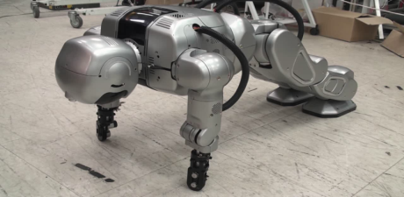
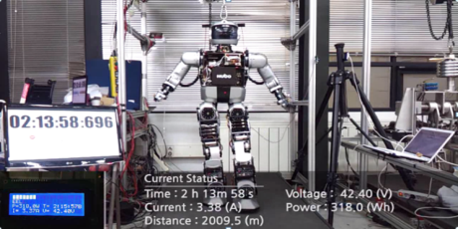
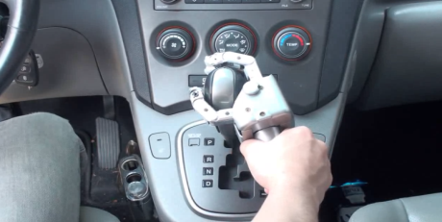
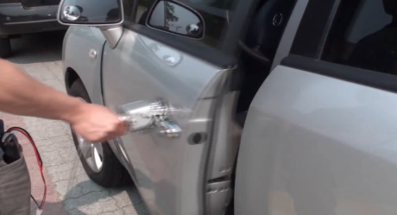
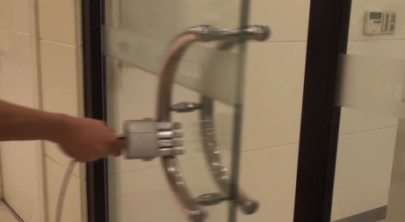
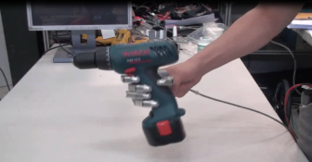
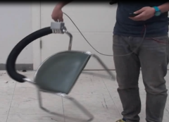
Hubo: Latest Capabilities Underscore Promise for DRC
Videos of capabilities: http://dasl.mem.drexel.edu/DRC
Approved for Public Release; Distribution Unlimited

Slide 5
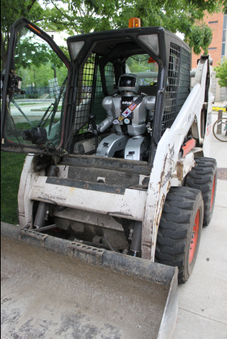
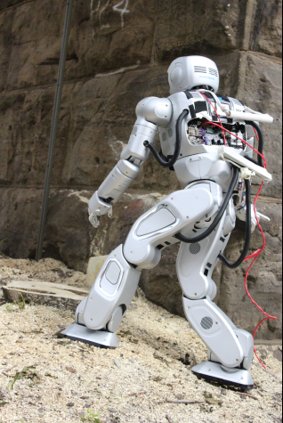
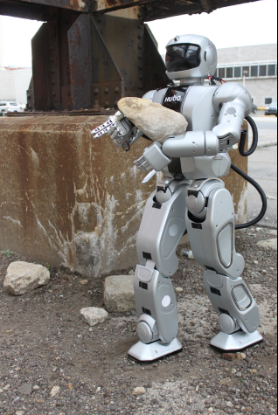
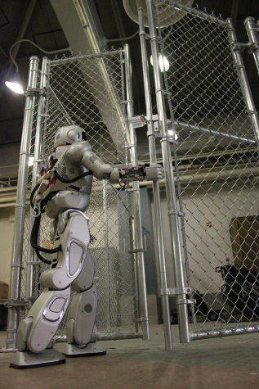
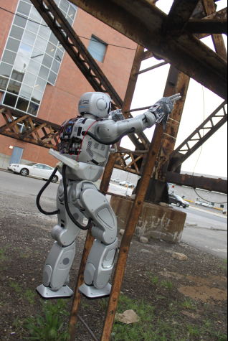
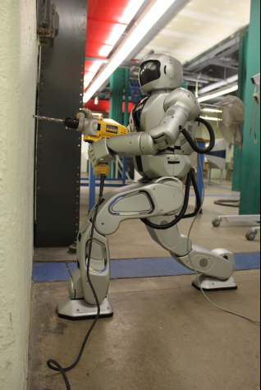
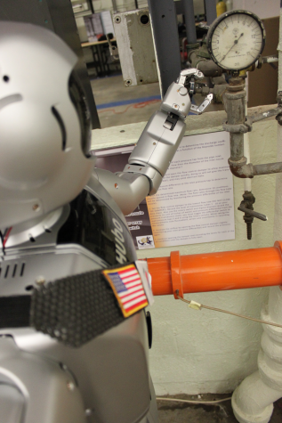
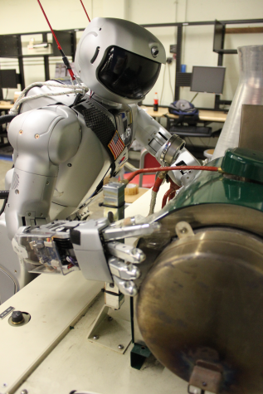
DRC-Hubo: Notional
Event 1: Vehicle
Event 2: Terrain
Event 3: Debris
Event 4: Door
Event 5: Ladder
Event 6: Wall Break
Event 7: Valve
Event 8: Pump
Approved for Public Release; Distribution Unlimited

Slide 6
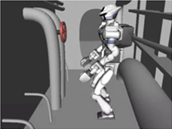
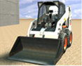
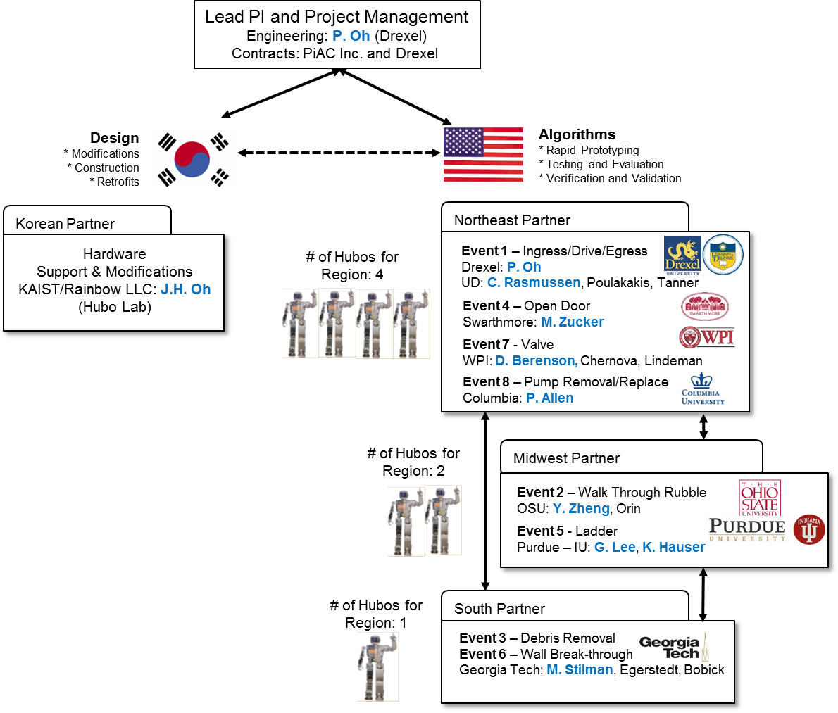
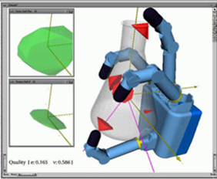
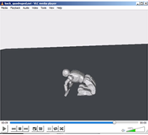
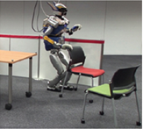
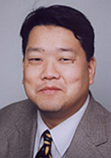
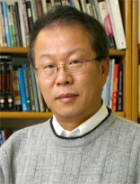
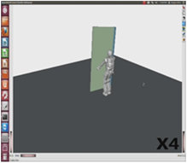


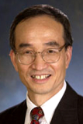
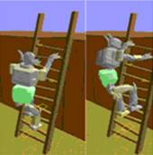



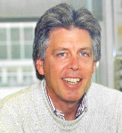
Dream Team: Domain Experts
(aka: Ocean’s 11 Approach)
P. Oh
Drexel
J.H. Oh
KAIST
C. Rasmussen
U Delaware
M. Stilman
Georgia Tech
M. Zucker
Swarthmore
Y. Zheng
Ohio State
Team DRC-Hubo
200+ person-years Expertise in Humanoids
G. Lee
Purdue
K. Hauser
Indiana U
D. Berenson
WPI
P. Allen
Columbia
Approved for Public Release; Distribution Unlimited

Slide 7
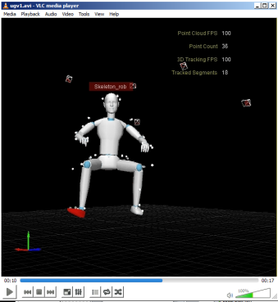
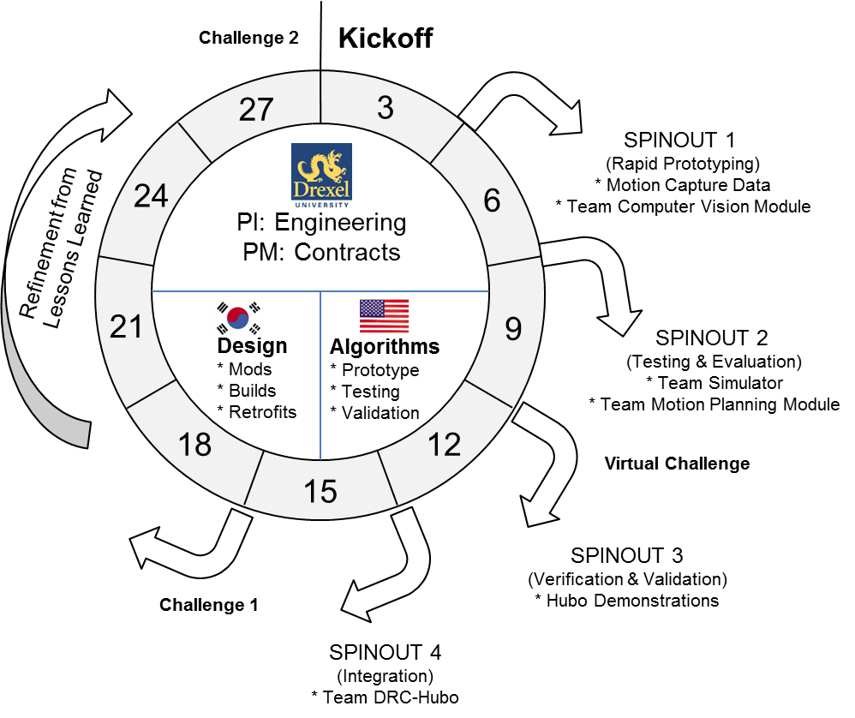
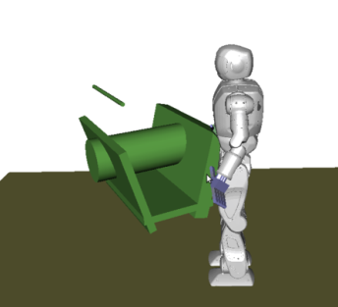
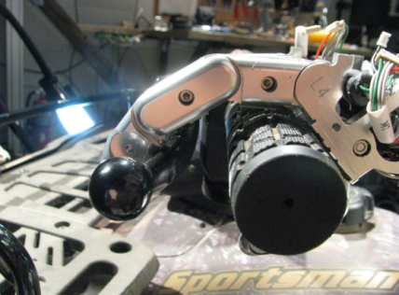
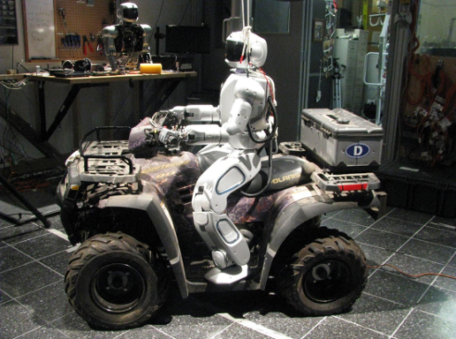
Spiral Development & 3-stage Design Cycle
(1) RP: Rapid Prototyping
(2) T&E: OpenHubo
(3) V&V: Hubo+ and DRC-Hubo
Approved for Public Release; Distribution Unlimited

Slide 8
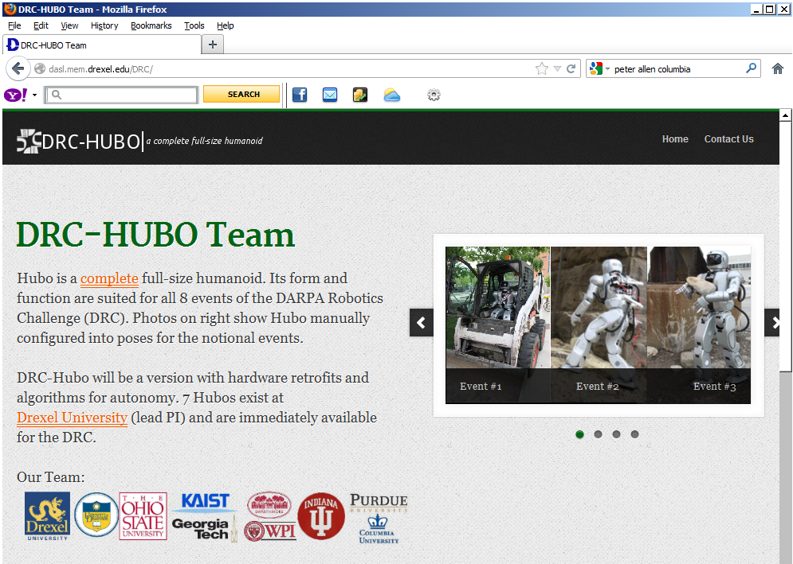
Please follow us on: http://dasl.mem.drexel.edu/DRC/
DRC: Validate training of US students in global design teaming and complex systems engineering (education)
DRC: Validate “Ocean’s 11” approach and benchmark results (research)
DRC: Validate design coupling of “brains” and “body”
“The views expressed are those of the author and do not reflect the official policy or position of the Department of Defense or the U.S. Government”
Approved for Public Release; Distribution Unlimited

